Slide 1

MIMO Radio Technology
Part I: Wi-Fi and LTE Standards
21-Oct-2013
Fanny Mlinarsky
octoScope, Inc.

Slide 2
Outline
In this lecture we will cover
  History of wireless and how we got to IEEE 802.11 (Wi-Fi) and 3GPP Long Term Evolution (LTE)
  Wireless technologies
  Wireless standards

Slide 3

Brief History of Wireless
5G
4G
Key wireless technologies
LTE-A
IEEE 802
802.11n/ac
3G
LTE
802.16e
802.11a/b/g
2G
WCDMA/HSxPA
Wireless capacity / throughput
GPRS
Analog
CDMA
GSM
Increasing throughput and capacity
IS-54
IS-136
TACS
AMPS
NMT
First cell phones
1970
1980
1990
2000
2010
2015
G = generation

Slide 4
The Gs
G |  | Peak Data Rate (Mbps)
 |  | Downlink | Uplink
1 | Analog | 19.2 kbps
2 | Digital – TDMA, CDMA | 14.4 kbps
3 | Improved CDMA variants (WCDMA, CDMA2000) | 144 kbps (1xRTT); 384 kbps (UMTS); 2.4 Mbps (EVDO)
3.5 | HSPA (today) | 14 Mbps | 2 Mbps
3.75 | HSPA (Release 7) DL 64QAM or 2x2 MIMO; UL 16QAM | 28 Mbps | 11.5 Mbps
 | HSPA (Release 8) DL 64QAM and 2x2 MIMO | 42 Mbps | 11.5 Mbps
3.9 | WiMAX Release 1.0 TDD (2:1 UL/DL ratio), 10 MHz channel | 40 Mbps | 10 Mbps
 | LTE, FDD 5 MHz UL/DL, 2 Layers DL | 43.2 Mbps | 21.6 Mbps
 | LTE CAT-3 | 100 Mbps | 50 Mbps
4 | LTE-Advanced | 1000 Mbps | 500 Mbps
5G? 802.11ac – up to 6.9 Gbps

Slide 5





4G vs. Legacy 2G Architecture
PSTN
HLR
VLR
GMSC
MSC 2
VLR
2G
Network
MSC 1
4G all-IP Network
BSC
GMSC = Gateway Mobile Switching Center
PSTN = public switched telephone network
BSC = base station controller
MSC = mobile switching center
VLR = visitor location register
HLR = home location register

Slide 6
3G Network Latency
  Traditional HSPA
  One tunnel HSPA
  One tunnel HSPA+
GGSN
GGSN
Gateway GPRS Support Node
GGSN
  One-tunnel architecture flattens the network by enabling a direct transport path for user data between RNC and the GGSN, thus minimizing delays and set-up time
Control Data
Serving
GPRS Support Node
SGSN
SGSN
SGSN
Radio Network Controller
RNC
RNC
User Data
RNC
Node B
Node B
Node B

Slide 7





LTE EPS (Evolved Packet System)
Flat, low-latency architecture
HSS
SGSN
GPRS Core
Trusted
MME
EPS Access Gateway
PCRF
Serving gateway PDN gateway
IP Services (IMS)
eNode-B
Trusted
Non-3GPP
Wi-Fi
SGSN = Serving GPRS Support Node
PCRF = policy and charging rules function
HSS = Home Subscriber Server
MME = Mobility Management Entity
PDN = Public Data Network
IMS = IP multimedia subsystem
eNode-B = enhanced Node B
Non-Trusted
Trusted non-3GPP IP Access (CDMA, TD-SCDMA, WiMAX)

Slide 8
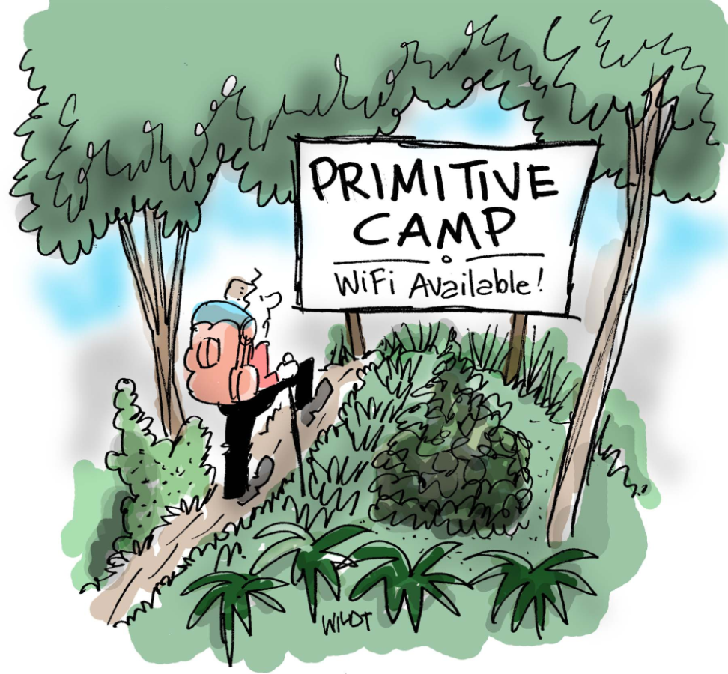
History of IEEE 802.11
1989: FCC authorizes ISM bands
  900 MHz, 2.4 GHz, 5 GHz
1990: IEEE begins work on 802.11
1994: 2.4 GHz products begin shipping
1997: 802.11 standard approved
1998: FCC authorizes UNII Band, 5 GHz
1999: 802.11a, b ratified
2003: 802.11g ratified
2006: 802.11n draft 2 certification by the Wi-Fi Alliance begins
2009: 802.11n certification
2013: 802.11ac (up to 6.9 Gbps) and 802.11ad (up to 6.8 Gbps)
802.11 has pioneered commercial deployment of OFDM and MIMO – key wireless signaling technologies
ISM = industrial, scientific and medical
UNII = Unlicensed National Information Infrastructure

Slide 9
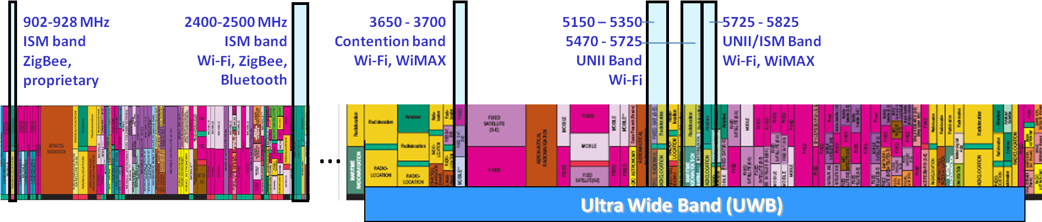
Key Unlicensed Bands
5.9 DSRC (connected vehicle)
700 MHz White Spaces
4.9 GHz public safety
5850–5925 MHz
MHz
3.1 GHz
10.6 GHz
FCC spectrum allocation chart
  http://www.ntia.doc.gov/osmhome/allochrt.PDF
DSRC = direct short range communications
Notes:
This is a partial view of the US spectrum allocation with the unlicensed bands highlighted. Proprietary services are marked in yellow. Standards based services are marked in blue. In the background is the US spectrum allocation chart which you can find at the link shown in the bottom of the slide.
The ISM-900 band, aka 915 MHz band is a valuable band because it is relatively wide (26 MHz in the US) and, being lower in frequency than other unlicensed bands, exhibits lower propagation losses, enabling long range transmission.
Long used by consumer devices such as cordless phones, garage openers and baby monitors, this band is now assuming a higher importance for new wireless applications involving smart metering and industrial controls.
The 2.4 GHz ISM band is heavily used by Wi-Fi and Bluetooth and due to its heavy use services in this band are known to interfere with one another. For this reason 802.11 a/n networks are being deployed more and more in the 5 GHz band where we have 23 channels available in the US. The 5 GHz band is subdivided into several sub-bands subject to slightly different restrictions. More on this later.
The 3650 to 3700 band is known as a ‘lightly licensed’ band or ‘contention band’ and only allows devices that implement contention protocol. This band was originally allocated for Wi-Fi but 802.16 (WiMAX) has also adapted its protocol to operate here. Today only WiMAX services operate in this band.
Cordless phones are found in virtually all unlicensed bands, all the way up to the 5 GHz band.
Ultra wide band (UWB) spans 7.5 GHz from 3.1 to 10.6 GHz. Devices in this band are restricted in signal strength to operate in the noise floor of other services. And hence UWB is relegated to short range links.
In the following slides we will cover spectrum regulations and wireless services in more detail.

Slide 10
U-NII Band
U-NII-1
100 MHz
U-NII-2A
100 MHz
New band
U-NII-2B
120 MHz
U-NII-2C
255 MHz
U-NII-3
100 MHz
25 MHz
New band
U-NII-4
75 MHz
Part 15.247
125 MHz
5.150
5.250
5.350
5.470
5.725
5.850
5.925
GHz
U-NII-1 = 5150-5250
U-NII-2A = 5250-5350
U-NII-2B = 5350-5470 NEW
U-NII-2C = 5470-5725
U-NII-3 = 5725-5825 (NEW Proposal to extend to 5850)
U-NII-4 = 5850-5925 (NEW)
UNII = Unlicensed National Information Infrastructure

Slide 11

LTE FDD vs. TDD
FDD (frequency division duplex)
  Paired channels
TDD (time division duplex)
  Single frequency channel for uplink an downlink
  Is more flexible than FDD in its proportioning of uplink vs. downlink bandwidth utilization
  Can ease spectrum allocation issues
TD-LTE
DL
UL
DL
UL

Slide 12
LTE Frequency Bands - FDD
Band | Uplink (UL) | Downlink (DL) | Regions
1 | 1920 -1980 MHz | 2110 - 2170 MHz | Europe, Asia
2 | 1850 -1910 MHz | 1930 - 1990 MHz | Americas, Asia
3 | 1710 -1785 MHz | 1805 -1880 MHz | Europe, Asia, Americas
4 | 1710 -1755 MHz | 2110 - 2155 MHz | Americas
5 | 824-849 MHz | 869 - 894 MHz | Americas
6 | 830 - 840 MHz | 875 - 885 MHz | Japan
7 | 2500 - 2570 MHz | 2620 - 2690 MHz | Europe, Asia
8 | 880 - 915 MHz | 925 - 960 MHz | Europe, Asia
9 | 1749.9 - 1784.9 MHz | 1844.9 - 1879.9 MHz | Japan
10 | 1710 -1770 MHz | 2110 - 2170 MHz | Americas
11 | 1427.9 - 1452.9 MHz | 1475.9 - 1500.9 MHz | Japan
12 | 698 - 716 MHz | 728 - 746 MHz | Americas
13 | 777 - 787 MHz | 746 - 756 MHz | Americas (Verizon)
14 | 788 - 798 MHz | 758 - 768 MHz | Americas (D-Block, public safety)
17 | 704 - 716 MHz | 734 - 746 MHz | Americas (AT&T)
18 | 815 – 830 MHz | 860 – 875 MHz
19 | 830 – 845 MHz | 875 – 890 MHz
20 | 832 – 862 MHz | 791 – 821 MHz
21 | 1447.9 – 1462.9 MHz | 1495.9 – 1510.9 MHz
Source: 3GPP TS 36.104; V10.1.0 (2010-12)
Notes:
This table shows the FDD bands that are allocated in different regions of the world. The regions are shown in right column. FDD spectrum is paired spectrum, so for each channel we have the uplink band and the downlink band. The FDD frequency range spans from around 700 MHz to just under 2700 MHz.

Slide 13
LTE Frequency Bands - TDD
Band | UL and DL | Regions
33 | 1900 - 1920 MHz | Europe, Asia (not Japan)
34 | 2010 - 2025 MHz | Europe, Asia
35 | 1850 - 1910 MHz
36 | 1930 - 1990 MHz
37 | 1910 - 1930 MHz
38 | 2570 - 2620 MHz | Europe
39 | 1880 - 1920 MHz | China
40 | 2300 – 2400 MHz | Europe, Asia
41 | 2496 – 2690 MHz | Americas (Clearwire LTE)
42 | 3400 – 3600 MHz
43 | 3600 – 3800 MHz
Source: 3GPP TS 36.104; V10.1.0 (2010-12)

Slide 14
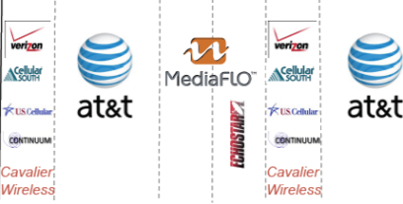
VHF/UHF Spectrum
CH 52-59, 692-746 MHz
A
B C
D E
A
B C
Acquired by AT&T
Band17
Band17
US White Spaces [2] [3]
54-72, 76-88, 174-216, 470-692 MHz
Band12
Band12
470 MHz
758 MHz
805 MHz
European White Spaces (470-790 MHz)
MHz
US Licensed UHF Spectrum
Public Safety Broadband (763-768, 793-798 MHz)
Public Safety Narrowband (769-775, 799-805 MHz)
D-Block (758-763, 788-793 MHz)
Low 700 MHz band
(commercial)
High 700 MHz band

Slide 15
White Space Spectrum Access
Spectrum access is database-driven. Database is designed to protect licensed TV transmitters from interference by unlicensed White Spaces devices.
DB 1
DB 2
GPS Satellite
Mode II Device
Geolocation
Source: Neal Mellen, TDK
Available channels
IETF PAWS
DB 3
Mode I Device
IETF = internet engineering task force
PAWS = protocol to access white space

Slide 16

IEEE 802.11 Very High Throughput
The goal of the 802.11 VHT effort is to achieve 1 Gbps throughput at nomadic (walking speeds) to support HD video transmission and high speed data applications and to satisfy the IMT-Advanced requirements
TGac and TGad
TGac
  Under 6 GHz (2.4 and 5 GHz bands)
  Up to 6.9 Gbps
  Higher order MIMO (> 4x4)
  8 spatial streams
  Multi-user (MU) MIMO
TGad
  60 GHz band
  Up to 6.8 Gbps
  Capitalize on work already done by 802.15.3c in the 60 GHz band
  Beamforming
VHT = very high throughput

Slide 17
802.11ac and Long Distance af/ah
Feb-2014
802.11ac
Very High Throughput (5 GHz)
802.11af
802.11ah
UHF (TV band)
Sub-1GHz (smart grid)
Mar-2014
Mar-2016
802.11af/ah derive their specifications from 802.11ac
Operation of 11af and 11ah is under 1 GHz
Support for longer delay spread outdoor deployments

Slide 18

IEEE 802.11 Active Task Groups
TGm – Maintenance
TGac – VHT below 6 GHz (very high throughput < 6 GHz)
TGad – VHT at 60 GHz
TGaf – TV Band operation
TGah – Operation in 900 MHz band
TGai – Fast initial link setup
TGaj – China Mili-Meter Wave
TGak – General Link
TGaq – Pre-Association Discovery
HEW SG - High Efficiency WLAN
ARC SC – Architecture
REG SC – Regulatory
WNG SC – Wireless Next Generation
http://grouper.ieee.org/groups/802/11
TG = task group
SG = study group
SC = standing committee

Slide 19
802.11 Past Task Groups
TGma – Maintenance
TGa – 5 GHz OFDM PHY
TGb – 2.4 GHz 11 Mbps; DSSS PHY
TGc – Bridging (part of 802.1)
TGd – Additional regulatory domains
TGe – Quality of Service
TGf – Inter-AP protocol
TGg – 2.4 GHz OFDM PHY
TGh – Radar avoidance (DFS, TPC)
TGi – Security
TGk – Radio Resource Measurements
TGn – High Throughput; MIMO
TGp – Vehicular ITS networks
TGr – Fast Roaming
TGs – Mesh networking
TGT – IEEE 802 Performance
TGu – InterWorking with External Networks
TGv – Wireless network management
TGw – Protected Management Frames
TGy – 3650-3700 MHz Operation in US
TGz – Direct Link Setup
TGaa – Robust streaming of AV Transport Streams
TGae – Prioritization of management frames
OFDM = orthogonal frequency division multiplexing
DSSS = direct sequence spread spectrum
ITS = intelligent transportation systems
MIMO = multiple input multiple output
DFS = dynamic frequency selection
TPC = transmit power control

Slide 20
IEEE 802.11 Timeline
TGk
TGma
TGmb
TGa
TGn
TGb
TGb-cor1
TGp
Part of
802.1
TGr
TGc
TGd
TGs
withdrawn
TGe
TGT
TGF
TGu
TGg
TGv
TGh
TGw
TGi
TGy
TGj
1997
1998
1999
2000
2001
2002
2003
2004
2005
2006
2007
2008
2009
2010
802.11-1999
IEEE Standard
April 1999
802.11-2007
IEEE Standard
June 2007
802.11-1997
IEEE Standard
July 1997

Slide 21
IEEE 802.11 Timeline (continued)
802.11-2012
Mar 29, 2012
802.11-2007
802.11k-2008
802.11r-2008
802.11y-2008
802.11w-2009
802.11n-2009
802.11p-2010
802.11z-2010
802.11v-2011
802.11u-2011
TGmb
TGm
TGp
TGs
Tgu
TGv
TGz
802.11-2015
TGaa
TGac
TGad
Mar, 2015
TGae
TGaf
TGah
TGai
http://grouper.ieee.org/groups/802/11/Reports/802.11_Timelines.htm
2008
2009
2010
2011
2012
2013
2014
2015
2016
2017
2018
2019
2020
2021

Slide 22
802.11 Emerging Specifications
Specification
Expected completion
Amendment
Overview
Transmission
rate
Communication
range
User
velocity
11ac
High Throughput
w/ wider channels
Up to
6.9 Gbps
Feb-2014
High Throughput
in 60 GHz band
Up to
6.8 Gbps
10 m at
1 Gbps
11ad
Oct-2012 Done
11af
Wi-Fi
on TV White Space
802.11n/ac rates scaled to channel
Up to
5 km
Mar-2014
11ah
Sub 1 GHz
> 100 kbps
1 km
Mar-2016
11ai
Fast initialization
(target 100 ms)
Target:
+ 200 km/h
Nov-2015
Wi-Fi for mobile
Pre-association Discovery
Select AP that provides needed services
May-2016
11aq
http://grouper.ieee.org/groups/802/11/Reports/802.11_Timelines.htm

Slide 23
LTE-Advanced Emerging Specifications
LTE-A features
Objectives
HetNet
Heterogeneous network
with Macro/Pico/Femto cells
Eliminate issues with Femto/Micro/Macro-cell
converged network
SON
Self Organizing Network
Self configuration of smaller eNBs
Carrier Aggregation
Implement wider LTE-advanced spectrum with limited spectrum resources.
{Asymmetric (DL/UL) band for FDD is available.}
3G / 4G Handover
Enable 3G-4G hand-over
(currently not available for LTE)
Higher order MIMO for Downlink
(Up to 8 X 8)
Higher data transmission for Downlink; beamforming for longer range or for multi-user MIMO
Relay
Higher data rate, Expand coverage,
Improve cell-edge reception
CoMP
Coordinated multi-point
transmission and reception
Helps manage band-edge eNB interference:
inter-cell interference coordination (ICIC)
eNB = e Node B
DL = downlink
UL = uplink
FDD = frequency division duplex
TDD = time division duplex

Slide 24
Summary
Many standards – exponential progress in technology
OFDM and MIMO common to 802.11 and LTE
Economies of scale bringing low cost of devices
802.11
  Pioneered OFDM and MIMO
  Widest channels (80 and 160 MHz wide)
All-IP wireless network architecture makes it easy for Wi-Fi and LTE to interconnect

Slide 25
Next Session
Part II: Morphing of Wi-Fi and LTE
Tuesday, October 22nd, 2013
2 pm EST
Visit www.octoscope.com for more material and test solution information

