Slide 1

MIMO Radio Technology
Part II: Morphing of Wi-Fi and LTE
22-Oct-2013
Fanny Mlinarsky
octoScope, Inc.

Slide 2
Outline
Today’s lecture will cover convergence of Wi-Fi and LTE under the wireless operator management
  Wi-Fi is becoming more like LTE
  LTE is becoming more like Wi-Fi

Slide 3

Smartphone at the Top of
Network Stack
Web access
CDMA
GSM WCDMA/HSxPA
Wi-Fi
Bluetooth
LTE
Email
Skype
VPN
File Sharing
Voice

Slide 4
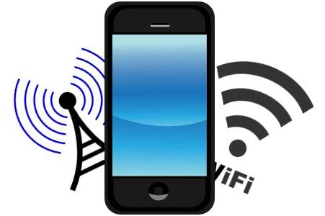
From the User Perspective
Smartphone challenges include
  Performance and responsiveness of apps
  Roaming functionality and speed
  Simultaneous operation of multiple radios
  Battery life

Slide 5
Convergence
Mobile network
Radio interfaces
Circuit calls
Bluetooth
Web access
Wi-Fi
Email
CDMA
VPN
WCDMA/HSxPA
File sharing
GSM
Handovers
LTE

Slide 6

Operators Adopting IP Architecture
Voice
Internet
Voice
Internet
Video
…
Billing/OSS
QoS
…
QoS
QoS
Billing/OSS
Presence
IMS
Network
Billing/OSS
Presence
Presence
Traditional
Cellular
Network
Stovepipe model – replicates functionality
IMS – common layers facilitate adding services

Slide 7




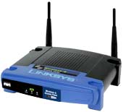
Key Components of the IMS Architecture
CSCF (call session control function)
  Heart of IMS architecture
  Handles multiple real-time IP based services (voice, IMM, streaming video, etc.)
  Responsible for registering user devices and for ensuring QoS
HSS (home subscriber server)
  Central repository for customer data
  Interfaces with operators HLRs (home location registers), which keep subscriber profiles
  Enables roaming across distinct access networks
AS (application server)
  Delivers services, such as gaming, video telephony, etc.
  Types of AS: SIP, Parlay X, customized legacy AS
Applications
Applications
Servers (AS)
Control
HSS
CSCF
Media
gateway
Transport
IP network, gateways to legacy networks

Slide 8

IMS Merges LTE/Wi-Fi/Wired
IMS optimizes architecture for services
IMS is being used in wired infrastructure to enable VoIP and other applications; LTE expands on this capability to deliver seamless services.
Hotspot-like initial deployments,
primarily in urban areas leverage
2G/3G for full coverage
Most LTE devices are multi-mode,
supporting 2G/3G and other interfaces
LTE femtocells are integrated in
the architecture from the
onset to increase capacity and
indoor coverage.

Slide 9
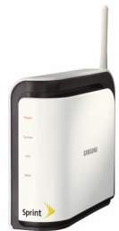
LTE Becoming More Like Wi-Fi with Smaller Cells
Cell size shrinks as throughput and usage increase
Throughput
# subscribers, throughput

Slide 10
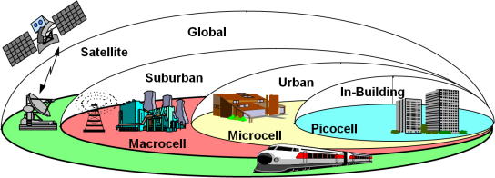
LTE / Wi-Fi Small Cells
Abundant Wi-Fi spectrum is now increasingly used by carriers to offload smartphone data traffic from the busy carrier networks
Shorter range smaller base stations displacing traditional tower-based Macrocells
FCC is working to free up more bandwidth and to remove burdensome regulations for microwave backhaul, enabling Wi-Fi backhauling
Picocell radius
r < 100m
Macrocell: r > 1km
Microcell: 100m < r < 1km

Slide 11
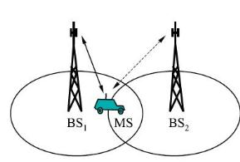
Handover Issues
Need for cooperation among 2G/3G/LTE and Wi-Fi
  Handoff without connection loss; voice call continuity
A voice call shall be able to originate or terminate across any wireless or wireline network

Slide 12
LTE-Advanced Facilitates Small Cells and Wi-Fi Cooperation
LTE-A Features
Objectives
HetNet
Heterogeneous network
with Macro/Pico/Femto cells
Eliminate issues with Femto/Micro/Macro-cell
converged network
SON
Self Organizing Network
Self configuration of smaller eNBs
Carrier Aggregation
Implement wider LTE-advanced spectrum with limited spectrum resources.
{Asymmetric (DL/UL) band for FDD is available.}
3G / 4G Handover
Enable 3G-4G hand-over
(currently not available for LTE)
Higher order MIMO for Downlink
(Up to 8 X 8)
Higher data transmission for Downlink; beamforming for longer range or for multi-user MIMO
Relay
Higher data rate, Expand coverage,
Improve cell-edge reception
CoMP
Coordinated multi-point
transmission and reception
Helps manage band-edge eNB interference:
inter-cell interference coordination (ICIC)
eNB = e Node B
DL = downlink
UL = uplink
FDD = frequency division duplex
TDD = time division duplex

Slide 13

802.11v Wireless Network Management
Manageability, improved power efficiency and interference avoidance
Defines a protocol for requesting and reporting location capability
  Location information may be CIVIC (street address) or GEO (longitude, latitude coordinates)
For the handset, TGv can enable awareness of AP e911 capabilities while the handset is in sleep mode; common ground with TGu

Slide 14
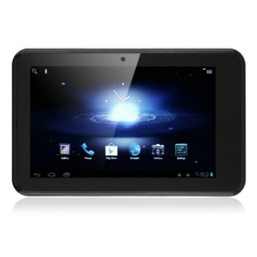
802.11u – 1st Sep in Making Wi-Fi More Like LTE
802.11u - InterWorking with External Networks
  Main goal is to enable Interworking with external networks, including other 802 based networks such as 3GPP based IMS networks and even 802.3 wired networks
  Manage network discovery, emergency call support (e911), roaming, location and availability
  The network discovery capabilities give a station looking to connect information about networks in range, service providers, subscription status with service providers
802.11u makes 802.11 networks more like cellular networks where such information is provided by the infrastructure
Network infrastructure
GAS server, etc.
GAS = Generic Advertisement Service

Slide 15
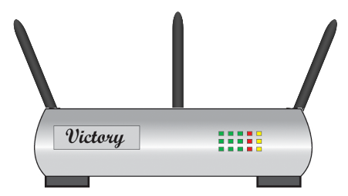
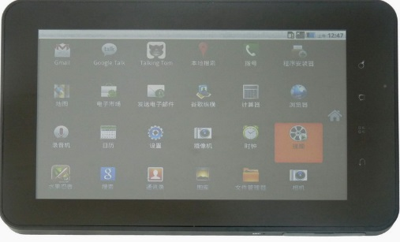
802.11aq Extension to 11u
Extend 802.11u to support service discovery prior to association
802.11aq
Service
query protocol
Services
ANQP…
GAS
Upper layer service
discovery protocol
ANQP = Access Network Query Protocol
GAS = Generic Advertisement Service

Slide 16
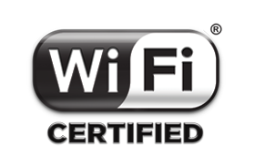

Wi-Fi Passpoint
Makes the process of finding and getting access to network seamless
Wi-Fi roaming
  Service providers are working together to define mechanisms for subscribers to “roam” to one another’s hotspots – just like in cellular networks
Provides WPA2™ security protection to user connections
Wi-Fi Alliance certification of mobile devices, such as handsets and tablets; certification of APs and network equipment
Both sides require certification to enable smooth connectivity experience
http://www.youtube.com/watch?v=hw2Z6OuNQE4&feature=youtu.be

Slide 17
802.11ai Makes Wi-Fi More Like LTE
When a high number of users simultaneously enter the Wi-Fi network, the time spent on link setup is minimized, while maintaining secure authentication
Mobile devices perform Internet access while entering or leaving a very crowded train station
Hot-Spot Pass-Through Internet Access - users on vehicle/train passing near an AP can access the Internet services in a few seconds
Electronic payments – at checkout counter or at the pickup window of a drive-through store, the customer pays electronically using their Wi-Fi capable smart phone or PC
Traveler information - ability to get map, navigation directions, local attractions, restaurants, etc. (e.g. iPhone app “AroundMe”)

Slide 18

Challenges on the Horizon
Wireless infrastructure
  Support millions of small cells (femto, pico)
  Manage interference among base stations
  Manage coexistence among diverse standards, including White Spaces
Mobile terminals
  Support multiple radio standards
  Roaming and handoff
  Application and network performance
  Cost, size, weight and battery life

Slide 19
Next Session
Part III: Why MIMO and OFDM?
Wednesday, October 23rd, 2013
2 pm EST
Visit www.octoscope.com for more material and test solution information

