Slide 1
MIMO Radio Technology
Part 3: Why MIMO and OFDM?
23-Oct-2013 Fanny Mlinarsky
octoScope, Inc.

Slide 2
Outline
This lecture will examine
Wireless performance issues, such as throughput, range and capacity
Advantages of MIMO and OFDM over legacy wireless technologies

Slide 3
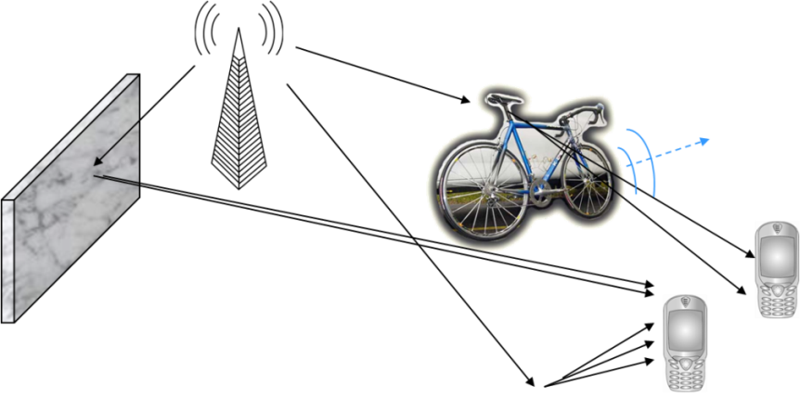
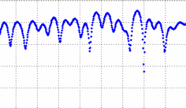
Path Loss and Multipath
In a wireless channel the signal propagating from TX to RX experiences fading and multipath
Free space loss (flat fading) increases vs. frequency
Fading can be ‘flat’ or it can have multipath components
Multipath can be caused by mobile or stationary reflectors.
Loss (dB) = 20 * Log₁₀ (frequency in MHz) + 20 * Log₁₀ (distance in miles) + 36.6
Path loss in free space
Distance | 5.8 GHz | 2.4 GHz | 915 MHz
160 feet | 81 dB | 74 dB | 65 dB
Multipath fading component
+10 dB
0 dB
-15 dB flat fading component
Time
Notes:
Signal impairments in a wireless channels include flat fading (aka attenuation), multipath and Doppler fading.
Multipath is caused by multiple versions of the transmitted signal formed by reflections from stationary and mobile objects. When multiple versions of the signal add out of phase, a null is formed. A typical multipath component of a received waveform is shown in the lower right plot and an example of a 15 dB flat fading component is shown below it. Of course, typically receive signal exhibits flat, multipath and doppler fading – all superimposed. When reflectors are mobile the nulls in the multipath components shift around in time and this effect is known as doppler fading. A common way of dealing with the nulls resulting from multipath is by receiving the signal using a variety of multiple antenna techniques. These techniques range from simple antenna diversity to MIMO. More on this later.
Flat fading increases as a function of frequency and this relationship is given by the formula on the left. A number of times through this presentation we mentioned that lower frequency spectrum exhibits lower losses and hence provides for higher operating range. So here are some numerical examples showing that a 915 MHz signal exhibits 9 dB less loss than a 2.4 GHz signal and 16 dB less loss than a 5.8 GHz signal.
As a rule of thumb, given typical impairments in a wireless channel
~6-9 dB of link budget increase typically doubles the outdoor range
~9-12 dB of link budget increase typically doubles the indoor range (more multipath indoors, eating up the link budget)

Slide 4
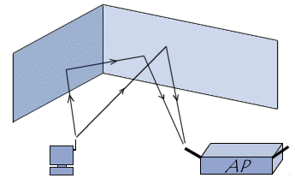
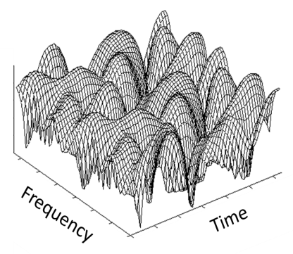
Why OFDM?
OFDM transforms a frequency- and time-variable fading channel into parallel correlated flat-fading channels, enabling wide bandwidth operation
…
…
Channel Quality
Frequency
Frequency-variable channel appears flat over the narrow band of an OFDM subcarrier.
OFDM = orthogonal frequency division multiplexing
MIMO = multiple input multiple output
Notes:
OFDM has proven to make the best use of the challenging wireless channel. The figure at the lower left shows that the quality of the wireless channel varies as a function of frequency and as a function of time. Even if I stand with my wireless device in one place, the signal at its receiver will fluctuate. The nulls in the signal are due to multipath and doppler fading. The wider the channel, the more difficult it is to equalize the received signal. OFDM takes a divide and conquer approach.
OFDM transforms the frequency- and time-variable fading channel into multiple parallel correlated flat-fading channels. The narrow channels of each OFDM subcarrier exhibit small variations, making equalization simple. Thus, the OFDM channel can be arbitrarily wide.
When OFDM is combined with multiple antenna techniques that we will discuss later, we can very effectively combat the time and frequency variability of the channel.

Slide 5
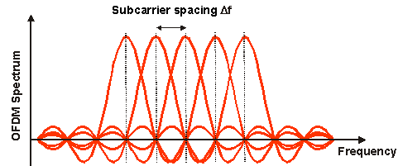
OFDM (Orthogonal Frequency Division Multiplexing)
Wi-Fi
LTE
Multiple orthogonal carriers
Voltage
Frequency
OFDM is the most robust signaling scheme for a hostile wireless channel
Works well in the presence of multipath thanks to multi-tone signaling and cyclic prefix (aka guard interval)
OFDM is used in all new wireless standards, including
802.11a, g and draft 802.11ac, ad
802.16d,e; 802.22
DVB-T, DVB-H, DAB
LTE is the first 3GPP standard to adopt OFDM
DVB = digital video broadcasting
DVB-T = DVB terrestrial
DVB-H = DVB handheld
DAB = digital audio broadcasting
LTE = long term evolution
OFDM = orthogonal frequency division multiplexing
Notes:
The basic principle of OFDM is to split a high-rate data stream into a number of parallel low-rate data streams, each a narrowband signal carried by a subcarrier.
When we talk about the channel, in the 2nd part of this session, you will see why a multicarrier scheme is so appropriate for the wireless channel.
The different narrowband streams are generated in the frequency domain and then combined to form the broadband stream using a mathematical algorithm called an Inverse Fast Fourier Transform (IFFT) that is implemented in digital-signal processors.
The system is called orthogonal, because the subcarriers are generated as orthogonal in the frequency domain and the IFFT conserves that characteristic. OFDM
systems may lose their orthogonal nature as a result of the Doppler shift induced by the speed of the transmitter or the receiver.

Slide 6
Cyclic Prefix
Guard interval > delay spread in the channel
Useful data
T_{S}
copy
Cyclic Prefix (CP) is a guard interval that allows multipath reflections from the previous symbol to settle prior to receiving the current symbol. CP has to be greater than the delay spread in the channel.
CP eliminates Intersymbol Interference (ISI) and makes the symbol easier to recover.
Notes:
This slide explains cyclic prefix, which serves to eliminate inter symbol interference. Cyclic prefix is also known as a guard interval. It is a copy from the end of the symbol and is a place holder between symbols. CP introduces period of time for all the multipath reflections in the channel to settle before the radio tries to decode the OFDM symbol. CP is a very effective method for eliminating inter-symbol interference or ISI.

Slide 7
OFDM vs. OFDMA
OFDM is a modulation scheme
OFDMA is a modulation and access scheme
Time
Time
Frequency
Frequency allocation per user is continuous vs. time
Frequency per user is dynamically allocated vs. time slots
User 1
User 2
User 3
User 4
User 5
OFDM/OFDMA = orthogonal frequency domain multiplexing / multiple access

Slide 8
LTE Resource Allocation
180 kHz, 12 subcarriers with normal CP
User 2
User 3
User 2
User 1
0.5 ms
7 symbols with normal CP
User 2
User 3
User 2
User 1
User 2
User 3
User 3
User 2
Time
User 2
User 1
User 3
User 2
User 1
User 1
User 3
User 1
Resource Block (RB)
Frequency
Resources are allocated per user in time and frequency. RB is the basic unit of allocation.
RB is 180 kHz by 0.5 ms; typically 12 subcarriers by 7 OFDM symbols, but the number of subcarriers and symbols can vary based on CP
CP = cyclic prefix

Slide 9
Resource Block
A resource block (RB) is a basic unit of access allocation. RB bandwidth per slot (0.5 ms) is 12 subcarriers times 15 kHz/subcarrier equal to 180 kHz.
1 slot, 0.5 ms
…
Resource block 12 subcarriers
…
…
Subcarrier (frequency)
Resource Element
1 subcarrier
QPSK: 2 bits
16 QAM: 4 bits
64 QAM: 6 bits
1 subcarrier
v
…
Time
Notes:
The multiple-access aspect of OFDMA comes from being able to assign different users
different subcarriers over time. A minimum resource block that the system can assign to
a user transmission consists of 12 subcarriers over 14 symbols (approx 1.0 msec.)

Slide 10
LTE Scalable Channel Bandwidth
Channel bandwidth in MHz
Transmission bandwidth in RBs
Center subcarrier (DC) not transmitted in DL
Channel bw
1.4 | 3 | 5 | 10 | 15 | 20
1.08 | 2.7 | 4.5 | 9 | 13.5 | 18
6 | 15 | 25 | 50 | 75 | 100
MHz
Transmission bw
# RBs per slot
Notes:
By having control over which subcarriers are assigned in which sectors, LTE can control frequency reuse. By using all the subcarriers in each sector, the system would
operate at a frequency reuse of 1; but by using a different one third of the subcarriers in each sector, the system achieves a looser frequency reuse of 1/3. The looser frequency reduces overall spectral efficiency but delivers high peak rates to users.

Slide 11
MIMO Systems
MIMO systems are typically described as NxM, where N is the number of transmitters and M is the number of receivers.
TX
TX
2x2
MIMO radio channel
RX
RX
TX
TX
RX
RX
MIMO = multiple input multiple output
2x2 radio
2x2 radio

Slide 12
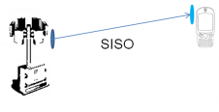
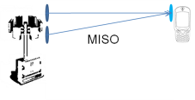
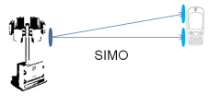
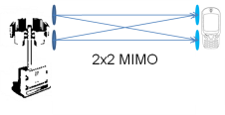
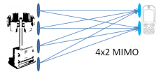
Multiple Antenna Techniques
SISO (Single Input Single Output)
Traditional radio
MISO (Multiple Input Single Output)
Transmit diversity (STBC, SFBC, CDD)
SIMO (Single Input Multiple Output)
Receive diversity, MRC
MIMO (Multiple Input Multiple Output)
SM to transmit multiple streams simultaneously; can be used in conjunction with CDD; works best in high SNR environments and channels de-correlated by multipath
TX and RX diversity, used independently or together; used to enhance throughput in the presence of adverse channel conditions
Beamforming
SM = spatial multiplexing
SFBC = space frequency block coding
STBC = space time block coding
CDD = cyclic delay diversity
MRC = maximal ratio combining
SM = Spatial Multiplexing
SNR = signal to noise ratio
Notes:
LTE uses a variety of multiple antenna techniques. Sometimes we loosely refer to these as MIMO (Multiple Input Multiple Output). MIMO enables spatial multiplexing whereby multiple streams of data (called layers in LTE) are transmitted in the same channel simultaneously. Spatial Multiplexing is only possible in a decorrelated channel and with multiple transmitters and receivers.
In addition to Spatial Multiplexing, Multiple antenna techniques include transmit and receive diversity in MISO, SIMO and MIMO configurations. Spatial Multiplexing typically requires high signal to noise ratio (SNR) conditions. In the presence of low SNR or excessive doppler, multiple transmitters can be used for transmit diversity such as Cyclic Delay Diversity CDD and multiple receivers can be used for receive diversity techniques such ash MRC maximal ratio combining. Both transmit and receive diversity can be used simultaneously, further improving the robustness of the channel. While spatial multiplexing of 2 layers has the potential of doubling the data rate, diversity techniques use multiple radios for redundant transmission of a single stream and hence have lower theoretical throughout. LTE MIMO radios can dynamically select Spatial Multiplexing in channel conditions that are suitable for this and then switch to transmit and receive diversity when channel conditions deteriorate.

Slide 13
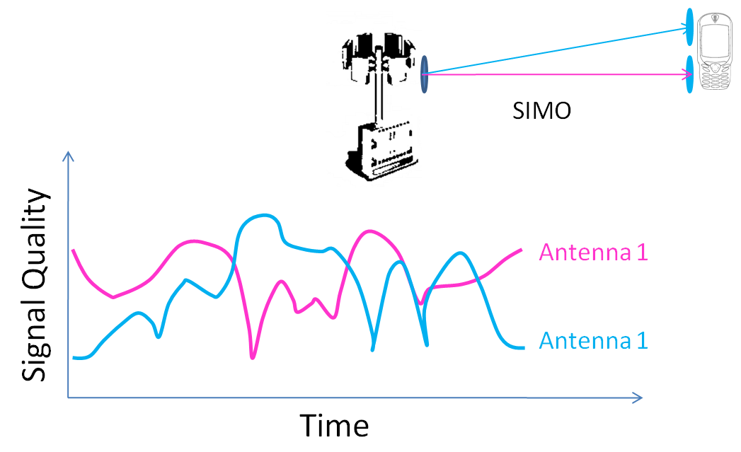
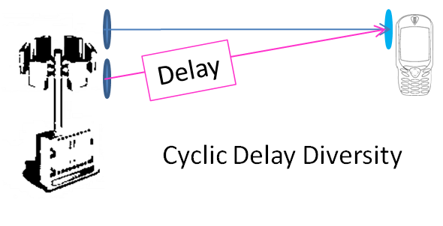
MIMO Based RX and TX Diversity
When 2 receivers are available in a MIMO radio MRC can be used instead of simple diversity to combine signals from two or more antennas, improving SNR
MIMO also enables transmit diversity techniques, including CDD, STBC, SFBC
TX diversity is used to spread the signal so as to create artificial multipath to decorrelate signals from different transmitters so as to optimize signal reception
Peak
Null
MIMO = multiple input multiple output
SIMO = single input multiple outputs
SM = spatial multiplexing
SFBC = space frequency block coding
STBC = space time block coding
CDD = cyclic delay diversity
MRC = maximal ratio combining
SM = Spatial Multiplexing
SNR = signal to noise ratio
Delay is inside the TX
Notes:
A MIMO device with multiple radios can implement transmit diversity in addition to receive diversity. Receive diversity on a MIMO device can also more sophisticated than on a single-radio device because the complete packet and not just preamble can be received by multiple receivers and then the receive source can be selected based on signal quality or by combining multiple received signals. This technique is known as maximal ratio combining (MRC).
One can think of receive diversity as analogous to having two ears and transmit diversity as analogous to having two mouths. Transmit diversity techniques aim to produce multiple versions of the same signal and they are specifically designed to carefully control the relationship of these multiple versions of the signal so as to optimize signal reception.
Transmit and receive diversity techniques can be used independently or together.
When channel conditions allow, MIMO radios can also use spatial multiplexing whereby multiple radios are used to transmit more than one simultaneous data stream thereby multiplying the capacity of the airlink.

Slide 14
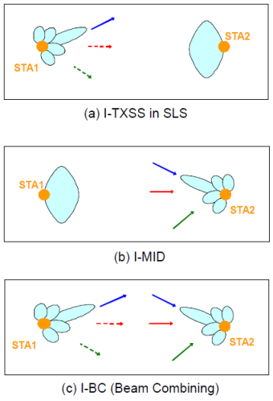
Beamforming and Beam Steering
Beamforming is a feature of 802.11ac and central to 802.11ad
Optimizes the range by focusing the energy between transmitting and receiving nodes

Slide 15
Data Rate Adaptation
MIMO radios adapt their operating mode to the changing channel conditions, optimizing throughput and minimizing PER
Example of rate adaptation is MCS adaptation employed by 802.11n/ac and LTE radios.
PER = packet error rate
MCS = modulation coding scheme

Slide 16
IEEE 802.11a,b,g,n Data Rates
 | 20 MHz Channel |  |  |  | 40 MHz Channel
 | 1 stream | 2 streams | 3 streams | 4 streams | 1 stream | 2 streams | 3 streams | 4 streams
 | Data Rate, in Mbps
802.11b 2.4 GHz | 1, 2, 5.5, 11
802.11a 5 GHz | 6, 9, 12, 18, 24, 36, 48, 54
802.11g 2.4 GHz | 1, 2, 6, 9, 12, 18, 24, 36, 48, 54
802.11n 2.4 and 5 GHz | 6.5, 13, 19.5, 26, 39, 52, 58.5, 65 | 13, 26, 39, 52, 78, 104, 117, 130 | 19.5, 39, 58.5, 78, 117, 156, 175.5, 195 | 26, 52, 78, 104, 156, 208, 234, 260 | 13.5, 27, 40.5, 54, 81, 108, 121.5, 135 | 27, 54, 81, 108, 162, 216, 243, 270 | 40.5, 81, 121.5, 162, 243, 324, 364.5, 405 | 54, 108, 162, 216, 324, 432, 486, 540
802.11n, SGI enabled 2.4 and 5 GHz | 7.2, 14.4, 21.7, 28.9, 43.3, 57.8, 65, 72.2 | 14.4, 28.9, 43.3, 57.8, 86.7, 115.6, 130, 144.4 | 21.7, 43.3, 65, 86.7, 130, 173.3, 195, 216.7 | 28.9, 57.8, 86.7, 115.6, 173.3, 231.1, 260, 288.9 | 15, 30, 45, 60, 90, 120, 135, 150 | 30, 60, 90, 120, 180, 240, 270, 300 | 45, 90, 135, 180, 270, 360, 405, 450 | 60, 120, 180, 240, 360, 480, 540, 600
SGI = short guard interval

Slide 17
Rate Adaptation Example – 11ac
Max 802.11ac data rate with 3 spatial streams
GI = guard interval
Source: IEEE P802.11ac/D7.0, September 2013; Table 22-48

Slide 18
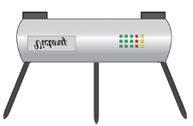
TGac – Next Generation Wi-Fi
Up to 6.9 Gbps of PHY data rate (draft 0.1)
Higher order MIMO (> 4x4)
8 spatial streams
Multi-user (MU) MIMO
Up to 4 users; up to 4 streams per user
Higher bandwidth channels (20, 40, 80, 80+80 and 160 MHz)
MU-MIMO
Multiple beamformed
streams in the same channel

Slide 19
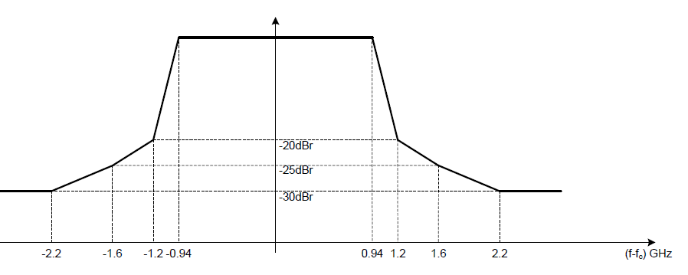
802.11ad 60 GHz Channels
Channel | f _{c} (GHz) | Country
1 | 58.32 | US
2 | 60.48 | US, Japan, EU, Australia
3 | 62.64 | US, Japan, EU
4 | 64.80 | Japan, EU
Channel 2 must be supported
IEEE 802.11ad is the key standard; other specifications are: 802.15.3c, ECMA-387, WirelessHD
EIRP: (40 dBm avg, 43 dBm peak in the US; 57 dBm in Europe, Japan and Australia
Channel spacing = 2160MHz

Slide 20
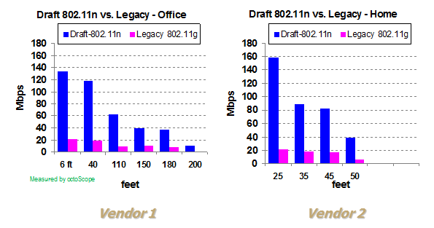
MIMO vs. SISO Throughput
MIMO = multiple input multiple output
SISO = single input single output

Slide 21
Wireless Performance Factors
Factors | Explanation/Impact | Notes
MIMO channel correlation | Function of several variables including device antenna spacing, antenna polarization and multipath | The lower the correlation the higher the throughput
Angular spread of the received signal | Related to correlation and strongly influenced by multipath in the channel | Multipath causes signal to bounce around and arrive at different angles, thereby widening the angular spread at a receiver. Typically, the wider the angular spread the higher the MIMO throughput.
Device antenna spacing and device orientation | Related to angular spread and correlation | MIMO throughput will vary vs. device orientation and antenna spacing. Typically, the wider the antenna spacing the lower the correlation and the higher the throughput.
Antenna polarization | Vertical, horizontal or circular | Cross-polarization (e.g. both vertical and horizontal) is sometimes used to lower MIMO correlation, thus enabling spatial multiplexing. Multipath reflections can alter polarization.

Slide 22
Wireless Performance Factors
Factors | Explanation/Impact | Notes
Noise and interference | High noise power with respect to signal power results in low SNR (signal to noise ratio) conditions. The term SINR (signal to interference + noise ratio) is sometimes used | MIMO devices can adapt to the environment by selecting the most suitable mode of operation (e.g. TX diversity in low SNR conditions; spatial multiplexing in high SNR, low correlation conditions)
Motion of devices or multipath reflectors | Causes Doppler spread of the signal | OFDM signaling is particularly sensitive to Doppler spread. Throughput should be measured in a variety of Doppler environments.

Slide 23
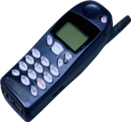
Escalating Complexity
Scheduling
Rate adaptation
HARQ
Data transmissions
Complex MIMO radio technology
Spatial multiplexing, TX/RX diversity, beamforming, MU-MIMO
Multiple radio networks (2G/3G/LTE, Wi-Fi)
Complex protocols
Mobility management (handover)
Cell-edge interference avoidance
Self-organizing behavior
Industry needs new generation sophisticated test methodologies to ensure devices and systems work in the field
Serving cell
Non-serving cell
MU = multi-user
MIMO = multiple input multiple output
HARQ = Hybrid Automatic Repeat ReQuest

Slide 24
Summary
Both the channel environment and the radio operating mode are time variable and interdependent, making it challenging to obtain repeatable test results.
OFDM and MIMO make it possible for radios to adapt to a variety of channel conditions.
Testing this adaptation behavior requires controlled emulation of different channel conditions, which is the subject of tomorrow’s lecture.

Slide 25
Next Session
Part IV: Measuring Wireless Performance
Thursday, October 24th, 2013
2 pm EST
Visit www.octoscope.com for more material and test solution information

