Slide 1

MIMO Radio Technology
Part IV: Measuring Wireless Performance
24-Oct-2013
Fanny Mlinarsky
octoScope, Inc.

Slide 2
Outline
This lecture will cover
  Test methods and metrics used to measure performance of wireless devices and systems
  Real-life vs. laboratory test methods

Slide 3
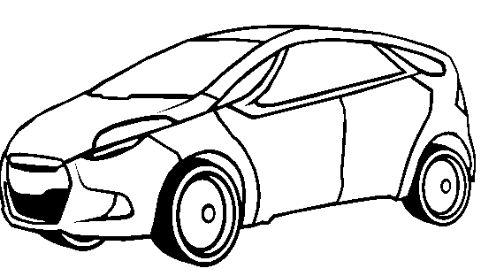
Many Things To Test
Range
Medium access behavior
Latency
Adjacent channel interference
Conformance
Backwards compatibility
Packet error rate
Interoperability
Authentication speed

Slide 4
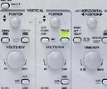
Many ‘Knobs’ Controlling the Test
Data traffic
Multipath
Interference
Noise
Radio density
Shadowing
Security
QoS
Motion of radios

Slide 5
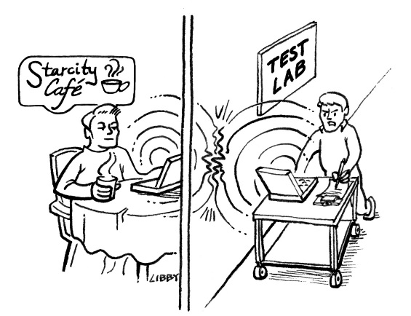
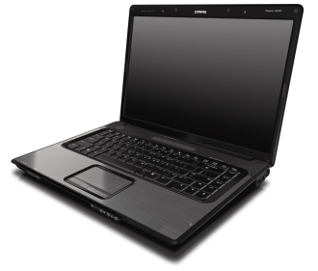
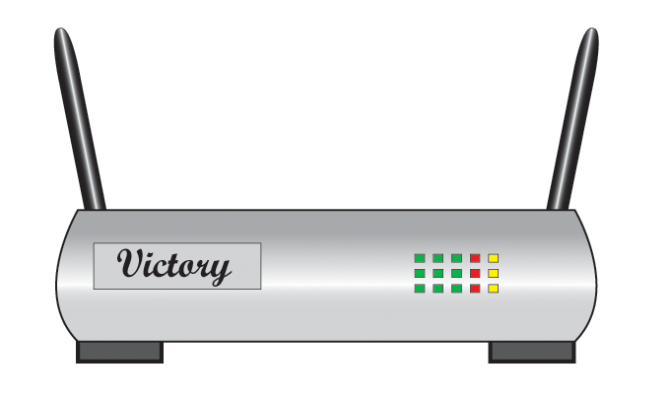
Open Air vs. Controlled RF Environment
Variability from test to test due to noise and interference
Throughput (frames per sec)
Stable, repeatable results in the controlled RF environment
Throughput (frames per sec)

Slide 6
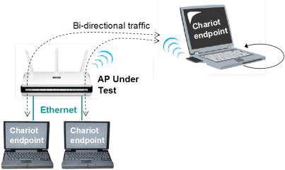

Open Air Throughput Test
DUT rotated on turntable or positioned at 0°, 90°, 180° and 270° for 4 measurements that are later averaged.
Open air testing (e.g. performance vs. distance) requires averaging results
  … vs. time - to cancel variability due to noise
  … vs. DUT orientation - to compensate
  for antenna field asymmetries
DUT = device under test

Slide 7
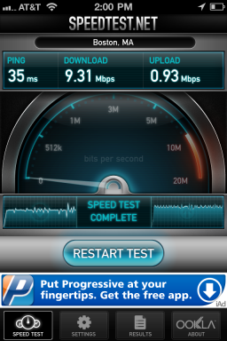
Open Air LTE Throughput Test
Informal drive-through testing of initial Verizon LTE deployments in the Boston area
Measure throughput using www.speedtest.net
Based on our sniffer measurements of the speedtest.net running on the desktop and iPhone:
  The program uses HTTP protocol to download and upload large images multiple times
The test runs for about 10 sec in each direction
Ookla operates speedtest.net using many servers around the world and routing the test traffic to the nearest server
  http://www.ookla.com/speedtest.php

Slide 8
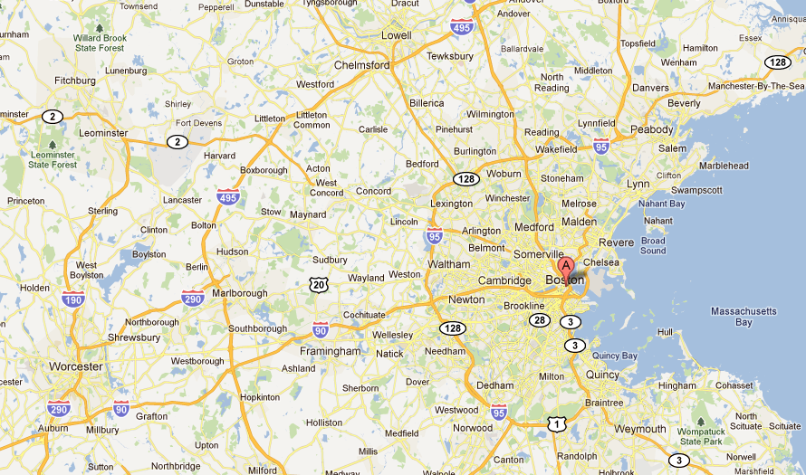
Verizon LTE Measurements

Slide 9
Verizon Throughput speedtest.com
kbps
msec
Date | ConnType | Download | Upload | Latency
10/2/2011 11:10 | Lte | 19518 | 4920 | 98
10/2/2011 11:10 | Lte | 19518 | 3983 | 106
10/2/2011 11:09 | Lte | 17300 | 2772 | 96
10/2/2011 11:05 | Ehrpd | 1917 | 1000 | 194
10/2/2011 11:00 | Ehrpd | 742 | 1000 | 148
10/2/2011 10:57 | Ehrpd | 1373 | 842 | 150
10/2/2011 10:56 | Ehrpd | 1910 | 901 | 180
10/2/2011 10:55 | Lte | 11467 | 309 | 98
10/2/2011 10:55 | Lte | 35694 | 6542 | 96
10/2/2011 10:54 | Lte | 31827 | 7324 | 97
10/2/2011 10:53 | Lte | 21281 | 7423 | 90
10/2/2011 10:53 | Lte | 9455 | 6937 | 90
10/2/2011 10:52 | Lte | 18291 | 4633 | 94
10/2/2011 10:39 | Ehrpd | 2341 | 954 | 179
10/2/2011 10:37 | Lte | 14298 | 989 | 94
10/2/2011 10:36 | Lte | 41880 | 7882 | 92
10/2/2011 10:36 | Lte | 34324 | 7346 | 92
10/2/2011 10:36 | Lte | 42962 | 8904 | 90
10/2/2011 10:35 | Lte | 44814 | 7583 | 94
10/2/2011 10:35 | Lte | 22561 | 9205 | 100
10/2/2011 10:35 | Lte | 14173 | 3284 | 104
10/2/2011 10:32 | Ehrpd | 1593 | 830 | 192
10/2/2011 10:29 | Lte | 8507 | 262 | 92
10/2/2011 10:29 | Lte | 12333 | 1002 | 97
10/2/2011 10:28 | Lte | 34996 | 10387 | 88
10/2/2011 10:28 | Lte | 49833 | 14801 | 85
10/2/2011 10:25 | Lte | 29931 | 8027 | 90
10/2/2011 10:25 | Lte | 20394 | 8460 | 100
10/2/2011 10:25 | Lte | 17250 | 5815 | 99

Slide 10
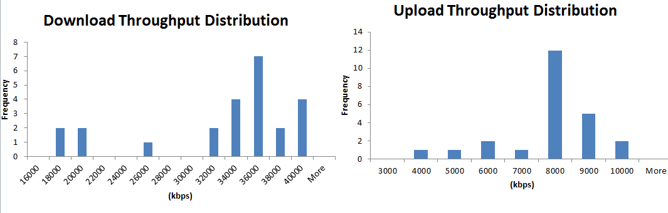
LTE Throughput Measured
Location in the car | DL (kbps) | UL (kbps) | Latency (ms)
Inside center of the car | 14800 | 5499 | 112
Inside driver front window | 14527 | 8824 | 107
Inside passenger front window | 13687 | 8001 | 111
Outside the car | 19703 | 8587 | 112
Impact of Speed (60 mph in open space)
36 Mbps DL
8 Mbps UL
Measurements performed by octoScope in October 2011
DL = downlink
UL = uplink

Slide 11
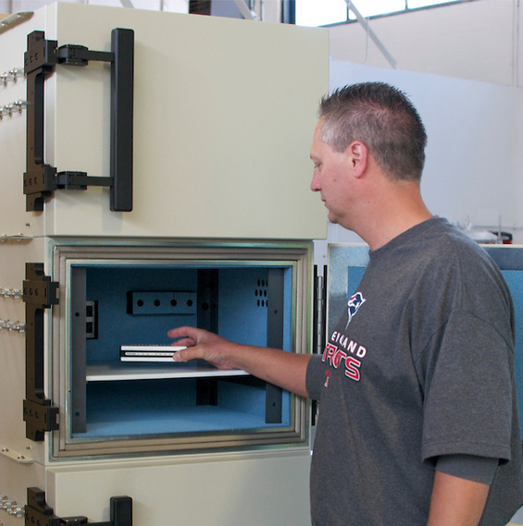
Controlled Environment Testing
Repeatable test results
Control over test conditions
Ease of test automation
RF isolated testbed enabling testing of new devices without the FCC authorization
Testbed can be replicated in multiple locations around the world (e.g. at multiple certification laboratories)
octoBox Stackable testbed

Slide 12

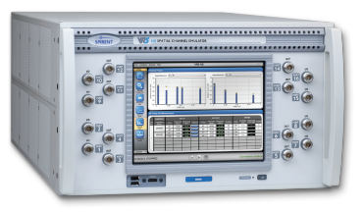

Controlled Environment Testing
Isolation box
Isolation box
Conducted
OTA
DUTs isolated from one another and from the outside world
Signal coupling can be conducted or over the air (OTA)

Slide 13
Wireless Test Standards of Note
2G/3G/LTE | Wi-Fi | Data transport | Applications | Smart Grid
3GPP RAN5 →ETSI →PTCRB/GCF (conformance, interoperability) CTIA (TIS/TRP MIMO-OTA SAR) | Wi-Fi Alliance (WMM, WPA, etc.) IEEE 802.11.2 (range, throughput, latency) | IETF RFC 2285, 2544, 2889 (packet loss, latency, jitter) | ITU-T Voice Quality P.800 (MOS); P.862 (PESQ); G.107 (R-Factor) IETF video quality RFC 4445 (MDI MLR, DF) | NIST SEP 2 interoperability
3GPP = 3rd generation partnership project
RAN = radio access network
IETF = internet engineering task force
RFC = request for comments
GCF = global certification forum
ITU = international telecommunication union
ETSI = European Telecommunications Standards Institute
CTIA = cellular telecommunications internet association
TIS = total isotropic sensitivity
TRP = total radiated power
MIMO = multiple input multiple output
OTA = over the air
SAR = specific absorption ratio
WMM = wireless multimedia
WPA = wireless protected access
NIST = national institute of standard and technology
SEP = smart energy profile
MOS = mean opinion score
PESQ = perceptual speech quality measure
R-Factor = rating factor
MDI = Media Delivery Index
MLR = media loss rate
DF = delay factor

Slide 14


Wi-Fi Alliance Certification
The Wi-Fi Alliance is a certification organization for the 802.11 industry
Responsible for certification testbed, test standards
Recently also created its own standard – Wi-Fi Direct – outside of the IEEE 802.11

Slide 15
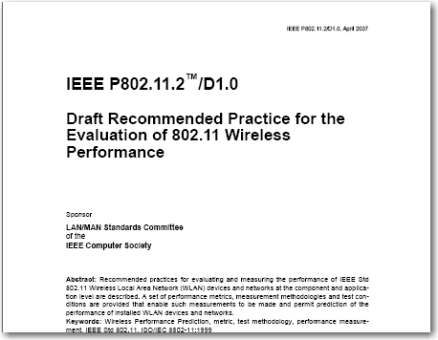
IEEE 802.11 Test Specification
IEEE 802.11.2, a recommended practices document, was developed by TGT
Defines methods and metrics for evaluating performance of 802.11 devices and systems

Slide 16
Examples of 802.11.2 Test Metrics
Unicast intra-BSS throughput
Unicast ESS throughput
Multicast forwarding rate
Endstation association rate
Endstation database capacity
Power consumption
Coexistence of overlapping BSSs in an OTA environment
Packet loss
Latency
Jitter
Video performance
Throughput: overall
Throughput vs. range
Throughput vs. attenuation (conducted and OTA)
Throughput vs. receive power
Transmit rate adaptation
Antenna diversity
Adjacent channel interference
BSS transition time
Fast BSS transition time
Receiver sensitivity in a conducted environment
BSS = basic service set

Slide 17
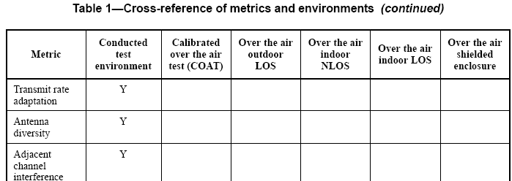
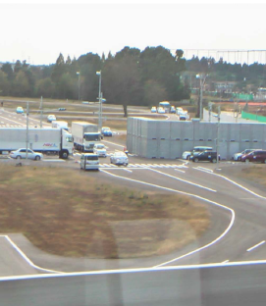
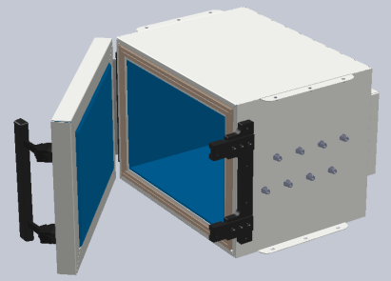
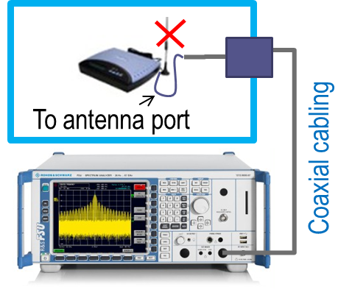
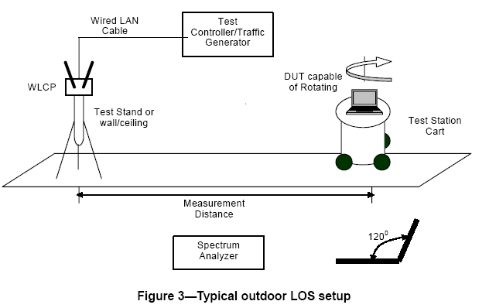
Test Environments per 802.11.2
√
√
Source: 802.11.2
√
…
√ = controlled environment

Slide 18
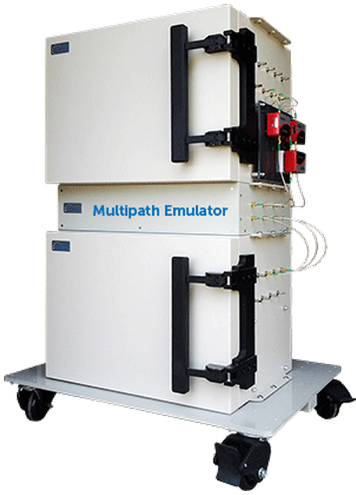
COAT Throughput Testing
MPE (multipath emulator) creates multipath inside octoBox small anechoic chamber by generating reflections with stubs of coaxial cable.
A multipath emulator fixture supports up to 4-stream MIMO.
See SmallNetBuilder.com article at this link:
  http://www.smallnetbuilder.com/wireless/wireless-features/32076-how-we-test-the-technology-behind-smallnetbuilders-new-wireless-testbed
COAT = calibrated over the air

Slide 19




COAT Testbed Block Diagram
MPE
Ethernet filter
Traffic TX/RX
Test traffic
Multipath segment
Traffic TX/RX
octoBox anechoic chamber
COAT = calibrated over the air

Slide 20
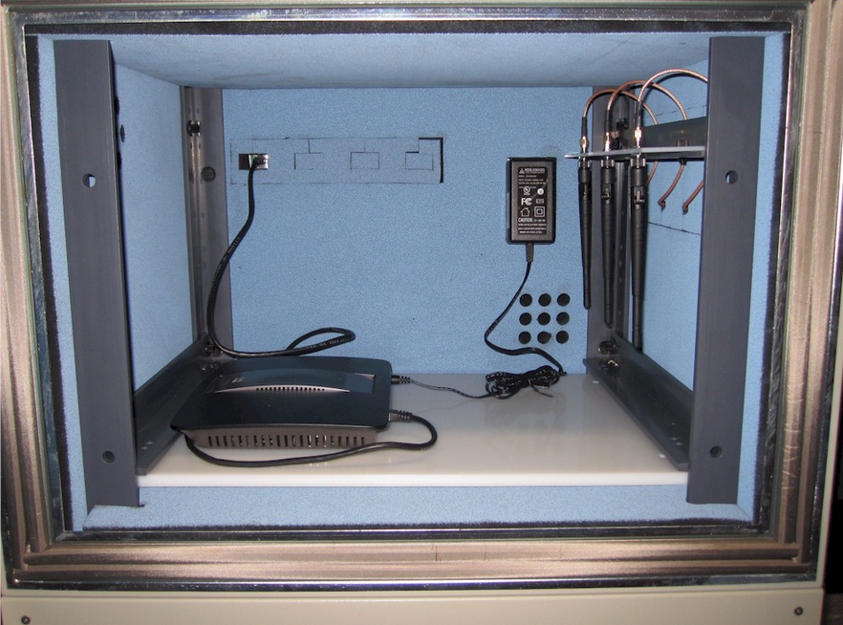
MIMO Test Antenna Array
  Source: http://www.smallnetbuilder.com/wireless/wireless-features/32076-how-we-test-the-technology-behind-smallnetbuilders-new-wireless-testbed

Slide 21
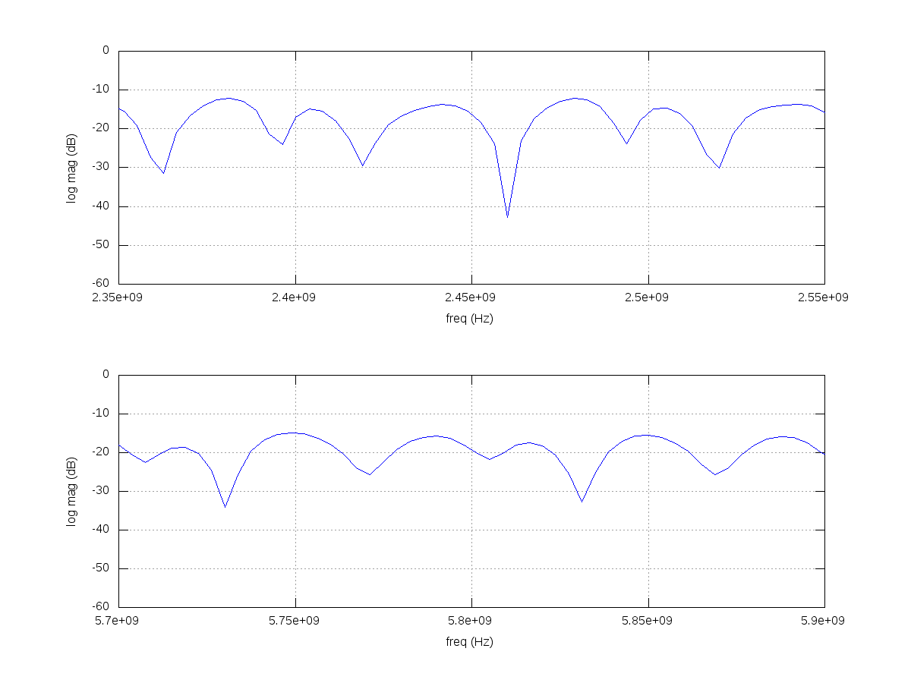
Multipath – Home Environment
2.4 GHz band
5 GHz band

Slide 22

Radio Performance Testing
RX sensitivity
TX spectrum, EVM
Range
Adaptive Modulation
Roaming behavior
Performance in the presence of noise and interference
Master
Isolation box
Noise/interference generator
Variable RF attenuator
RF combiner
DUT
DUT = device under test
EVM = error vector magnitude

Slide 23
3GPP Groups and Certification
RAN1
TX/RX DSP
RAN1-4 develop the functionality standards
RAN5 develops test specifications
ETSI develops TTCN code per RAN5 standards and makes code available as open source
Test equipment manufacturers are active contributors to the TTCN effort
RAN2
Signaling
RAN4
RF and channel
RAN5
RF Cert
RAN5
Signaling Cert
ETSI
(TTCN)
Test Equipment
eNB emulators
3GPP = 3rd generation partnership project
RAN = radio access network
GCF = global certification forum
ETSI = European Telecommunications Standards Institute
TTCN = Testing and Test Control Notation
GCF
PTCRB

Slide 24

Handset Certification Testbed
eNB emulator (call box)
Test script libraries, TTCN-3
Protocol
Software
MAC, RLC, MM, CC, SM, TC Layers
Baseband signal generator
Baseband signal analyzer
Interference and spectrum tests (e.g. blocking, spurious, etc.)
Interference and noise generator
Channel emulator
RF Spectrum Analyzer
RF combiner
RF VSA
RF VSG
VSA = vector signal analyzer
VSG = vector signal generator
MAC = medium access control
RLC = radio link control
MM = mobility management
CC = call control
SM = session management
TC = test control
Wi-Fi AP/AP emulator
TTCN = testing and test control notation
UE = user equipment
eNB = enhanced node B
PHY = physical layer

Slide 25
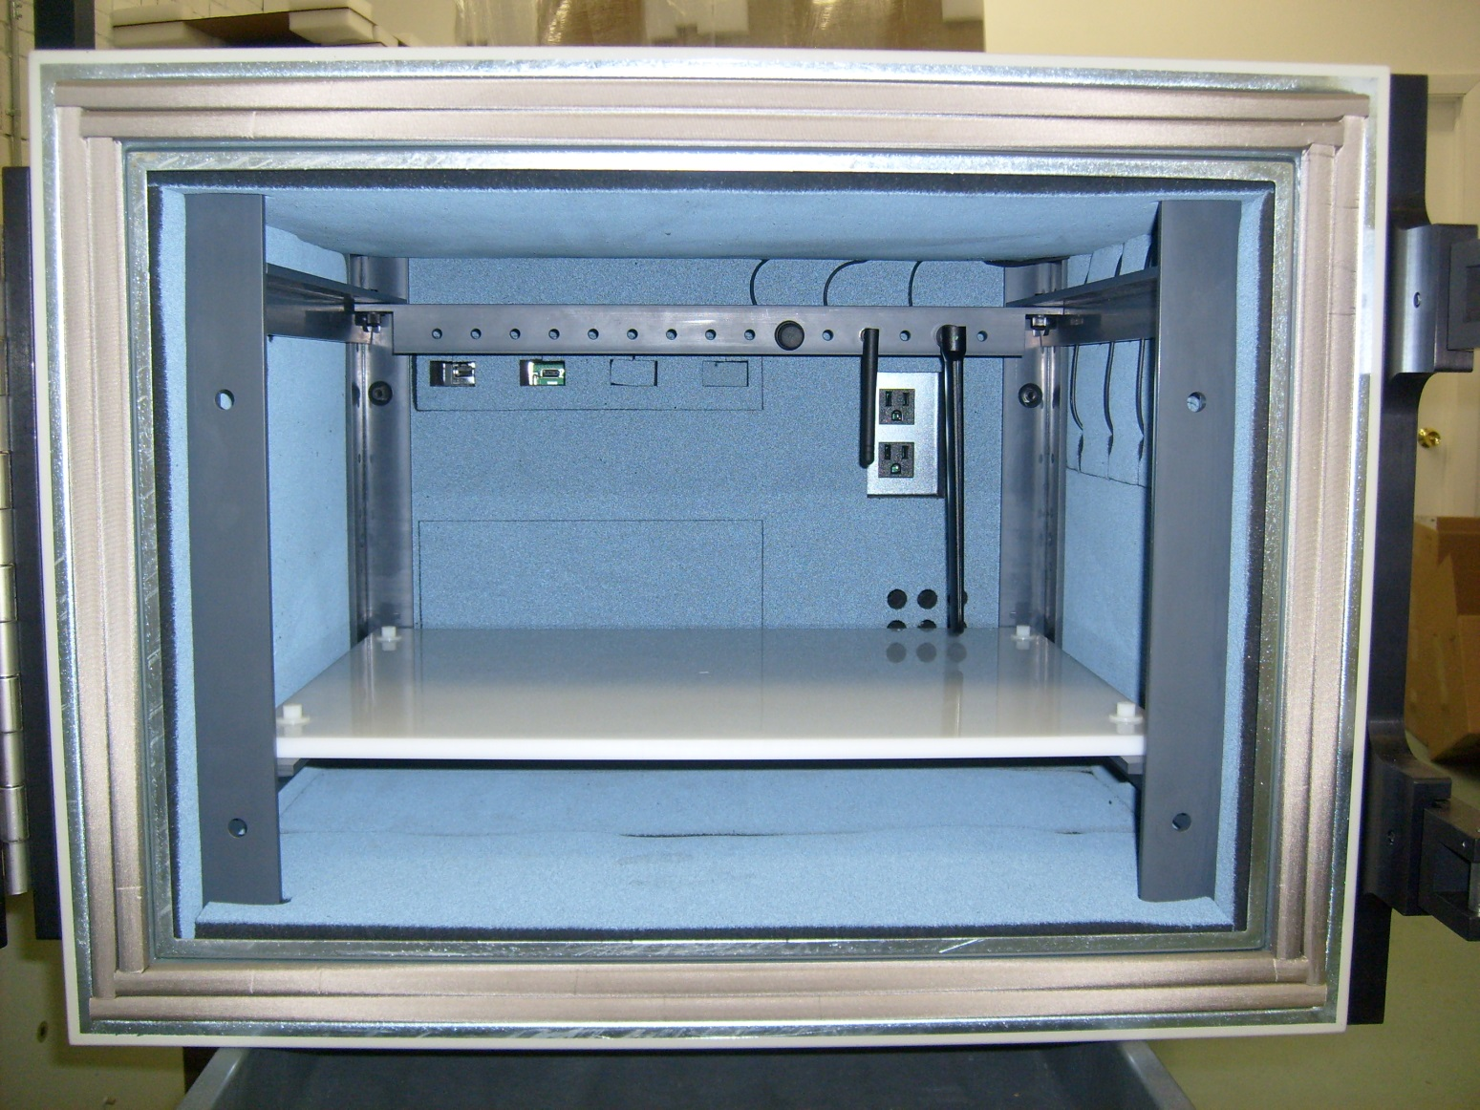
GPS antenna
Filtered USB
Wi-Fi
antenna
Filtered Ethernet
Cellular
antenna
octoBox RF test environment for OTA testing of multi-radio devices
OTA = over the air

Slide 26
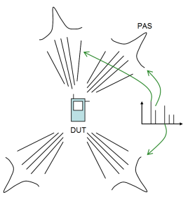
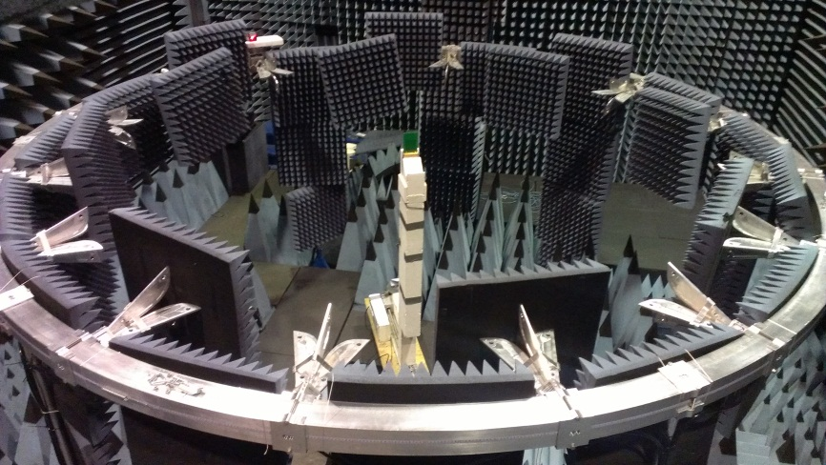
MIMO-OTA Large Anechoic Chamber Based Testbed
Base Station Emulator
Channel Emulator
RF Amplifier and
Calibration
Subsystem

Slide 27
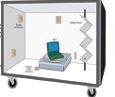
MIMO OTA Standards
MIMO OTA test metrics are being standardized by 3GPP and CTIA; Wi-Fi Alliance may be joining
Anechoic chamber
  DUT is surround by multiple antennas inside the chamber
  Multi-cluster 2D measurements on a plane
Reverberation chamber
  Uniform isotropic (3D) propagation is achieved via reflections from metal walls and mechanical stirrers
  An external channel emulator is used to provide power delay profiles, Doppler and multipath fading

Slide 28
Concluding Thoughts
There are many variables in the field that impact performance
Upfront design and pre-deployment testing in the lab will make deployment easier and more successful
Ability to record field conditions and reproduce them in the lab can be extremely helpful in QA test
QA = quality assurance

Slide 29
Next Session
Part V: Connected World
Friday, October 25th, 2013
2 pm EST
Visit www.octoscope.com for more material and test solution information

