Slide 1

MIMO Radio Technology
Part V: Connected World
25-Oct-2013
Fanny Mlinarsky
octoScope, Inc.

Slide 2
Outline
Discuss a wide variety of emerging wireless applications and their requirements for network performance
Wrap up any loose ends from the previous lectures and answer any questions

Slide 3
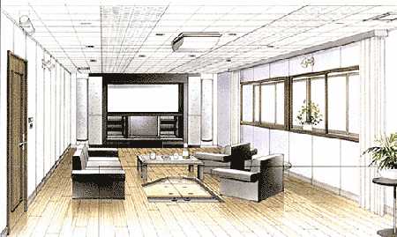
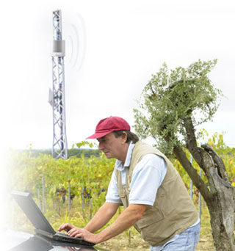
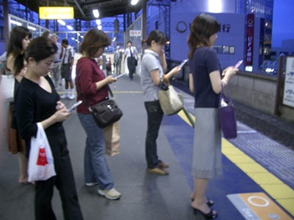

Wireless Apps – Where to Begin?

Slide 4
Wireless Apps
Cellular
Wireless broadband
Internet of things
M2M
Smart grid
Public Safety
Connected vehicle

Slide 5
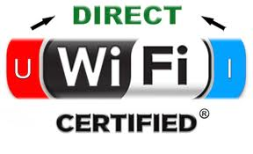
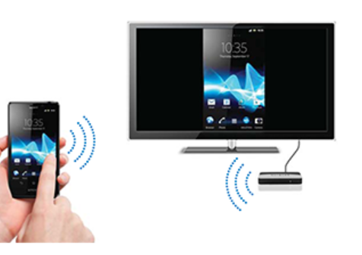

Wi-Fi Alliance Busy with Video
802.11n/ac/ad

Slide 6
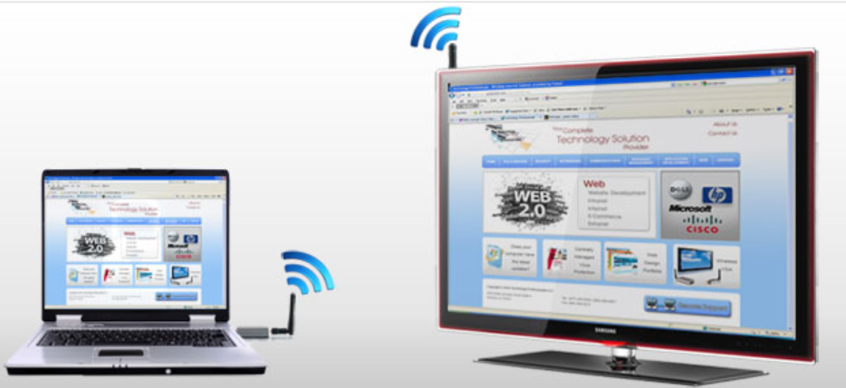
Wireless HDMI and PCIe Extension
Throughput
Throughput
Throughput
802.11a3
(60 GHz)
Short range – intended for video and PCIe extension
Same airlink; almost 14 Gbps parallel throughput
802.11ac
(<6 GHz)

Slide 7


Source: http://www.engadget.com/2012/12/03/volvo-self-driving-cars-2014/

Slide 8
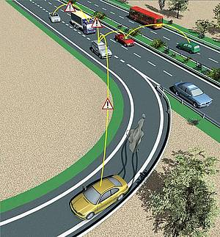
ITS –> Self-driving Cars
802.11p or LTE?
Crash avoidance
  Emergency electronic brake light
  Forward collision warning
  Blind spot warning / lane change warning
  Do not pass warning
  Left turn assist
Safety assist
  Remote diagnosis (EV battery monitoring)
  Stopped vehicle or pedestrian warning
  Road condition warning
Convenience
  Toll collection
  Charging station guidance / info for EV
  Mobile commerce / mobile advertisement
  Web browsing, File (video, audio) downloading
ITS = Intelligent Transportation Systems

Slide 9
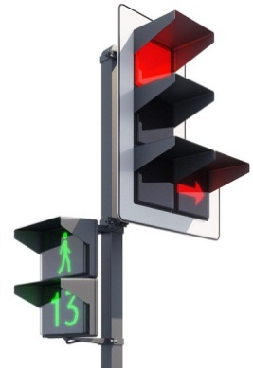

DSRC Stack
Intersection Collision Warning
Pre-Crash Sensing
Do Not Pass Warning
Applications
Electronic Brake Light Warning
Left Turn Across Path Warning
…
Protocol
IEEE 1609
ETSI TC-ITS
Radio
IEEE 802.11p
DSRC = direct short range communications

Slide 10


DSRC Radio Challenges
Fast motion of radios
Fast motion of reflectors
Challenging multipath conditions
  E.g. urban tunnels can result in long delays on strong multipath reflections that 802.11 OFDM is not designed to handle*
Data traffic congestion scenarios
  High density of radios and ‘hidden node’ scenarios could cause inefficiencies in the 802.11 CSMA/CA protocol, which in turn could result in a high PER
* Described by 3GPP Urban Macro and Urban Micro channel models
CSMA/CA = carrier sense multiple access with collision avoidance
PER = packet error rate
OFDM = orthogonal frequency division multiplexing

Slide 11
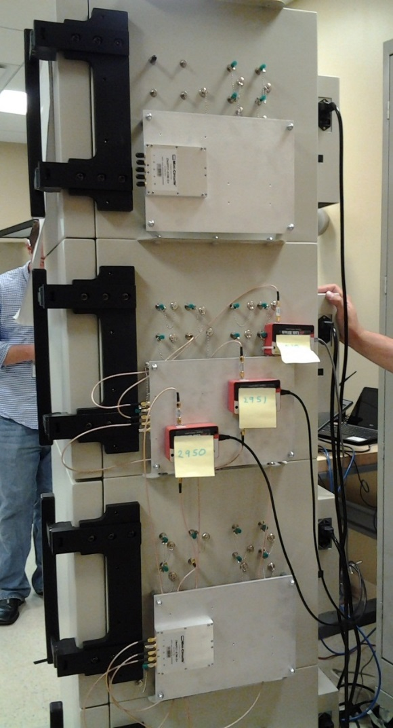
Controlled Environment Testing
Important to ensure success of
  Bandwidth-demanding applications such as wireless video and
  Mission critical applications such as self-driving cards
Laboratory testbeds can measure throughput, capacity, roaming, adaptation behavior
www.octoscope.com octoBox testbed

Slide 12
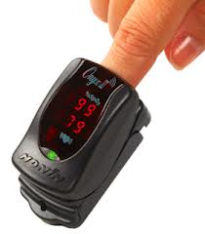
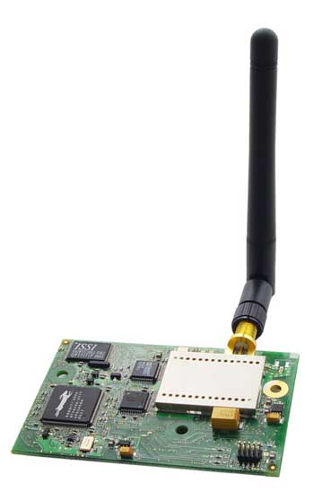
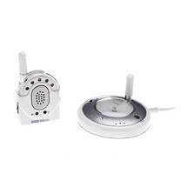
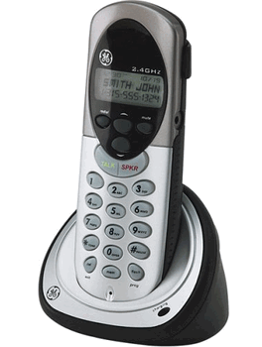





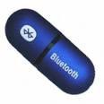

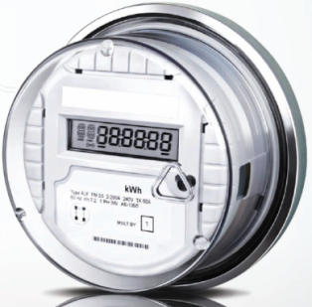

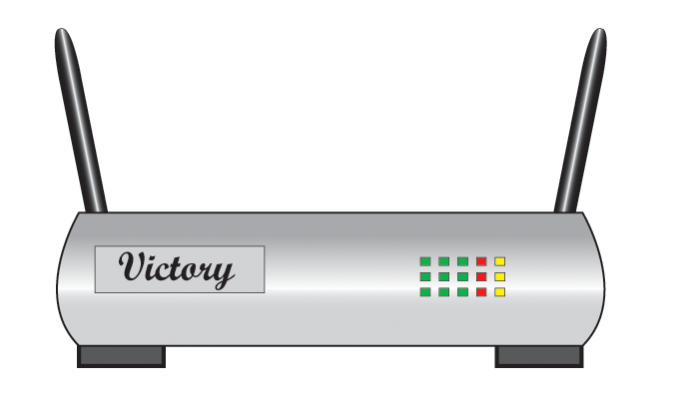
Unlicensed Wireless
Standards Based
Proprietary
Cordless phone
Smoke detector
Baby monitor
Alarm panel
Motion detector
Flood/water detector
Smart meter
Notes:
Throughout this seminar we will focus on the unlicensed wireless market. Wireless products fall into 2 categories: standards based and proprietary.
Among standards-based services, IEEE 802.11 (or Wi-Fi) is the most mature. Today almost all laptops, netbooks and now smart phones have Wi-Fi interfaces and this trend is expected to continue for some time to come.
Bluetooth is another highly successful standards based technology now incorporated into nearly every phone and into more than a billion headsets. And these two popular technologies (Wi-Fi and Bluetooth) are becoming intertwined with the latest release of Bluetooth now able to run over Wi-Fi to send large data, music and video files. And chipsets supporting both Wi-Fi and Bluetooth are starting to appear on the market.
WiMedia is intended for short-range high data rate links such as wireless USB and HD video transport. WiMedia has not yet gained a widespread market acceptance.
ZigBee is an emerging standard positioned to address low data rate applications, such as smart grid, medical equipment and sensor networks. ZigBee is contending for this market with highly optimized proprietary solutions.
Proprietary wireless solutions range from smart phones to baby monitors to garage openers and motion detectors. Over 200M proprietary devices are in use today in the US alone. Optimized for long battery life, long range and low cost, proprietary solutions compete with the emerging ZigBee based systems in applications such as smart metering and industrial controls.

Slide 13
Unlicensed Sub-1 GHz Band
aka 915 MHz
Lower frequency = longer operating range
Internationally available bands in the vicinity of 915 MHz supported by common radio chipsets
Two emerging IEEE 802 wireless standards target this band for smart metering and industrial controls applications
Region | Unlicensed Band (MHz)
Europe | 963-868.6
Japan | 915.9-928.1
China | 755-787
Korea | 917-923.5
Singapore | 920-925
US | 902-928
802.11ah
802.15.4g

Slide 14
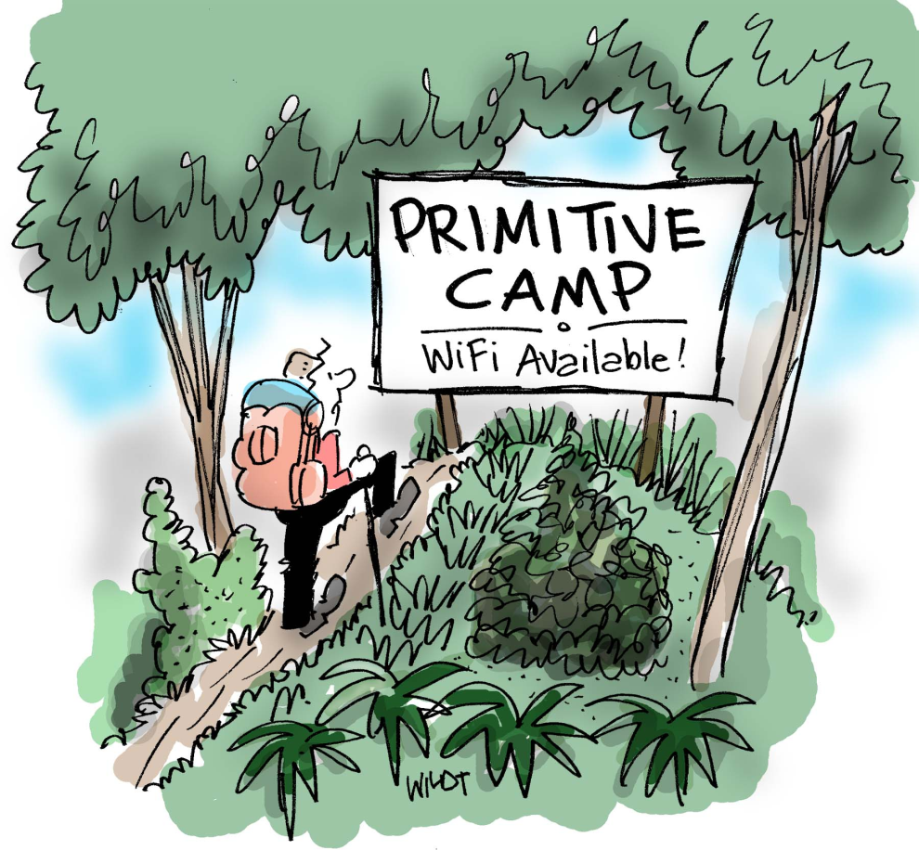
802.11ah Sub 1 GHz License-exempt
More than 100 kbps with coverage of up to 1 km; 600 kHz to 20 MHz channel bandwidth
Smart grid – extremely large number of stations (6000 stations per AP)
Environmental and agricultural monitoring – moderately large number of stations (200 per AP)
Healthcare and building automation – dozens of stations
Outdoor application for extended range Wi-Fi – common ground with 802.11af White Spaces amendment
AP = access point

Slide 15
802.11ac and Long Distance af/ah
Feb-2014
802.11ac
Very High Throughput (5 GHz)
802.11af
802.11ah
UHF (TV band)
Sub-1GHz (smart grid)
Mar-2014
Mar-2016
802.11af/ah derive their specifications from 802.11ac
Operation of 11af and 11ah is under 1 GHz
Support for longer delay spread outdoor deployments

Slide 16
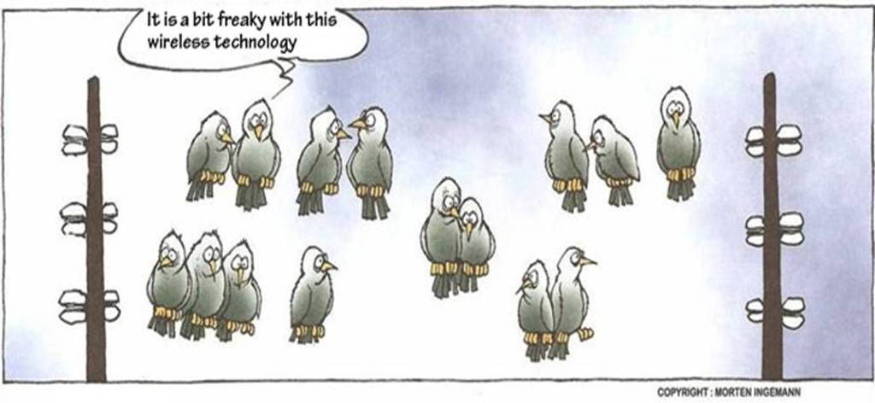
Sub 1 GHz Wi-Fi for Smart Grid
Source: www.youknowfunny.com/2010/11/wireless-technology.html

Slide 17





IEEE 802.24 Smart Grid ECSG
Serves as a single point of contact for questions regarding the use of 802 standards in Smart Grid applications
Covers wired and wireless 802 protocols
Acts as a liaison with regulatory agencies, industry organizations, other SDOs, government agencies, IEEE societies
Acts as a resource for understanding 802 standards for certification efforts by industry bodies.
http://www.iec.ch/smartgrid/
http://summit.utc.org/
http://collaborate.nist.gov/twiki-sggrid/bin/view/SmartGrid/PAP02Wireless?sortcol=1;table=9;up=0
http://osgug.ucaiug.org/default.aspx
http://www.ieee-pes.org/
PES = power energy society
OpenSG = open smart grid
UTC = utilities telecom council
IEC = international electrotechnical commission
ECSG = executive committee study group
SDO = standards defining organization

Slide 18



SEP 2 Architecture
Smart Grid application 1
Smart Grid application 1
…
Applications
IP layer
  www.homeplug.org
  www.wi-fi.org
  www.zigbee.org
…
Radio technologies
SEP 2 was selected in 2009 by the NIST as a standard profile for smart energy
Smart Grid Interoperability Panel (SGIP) sets guidelines for smart grid testing and certification programs.
SEP = smart energy profile
NIST = national institute of standards and technology
Notes:
SEP2.0 replaces the ZigBee Pro protocol stack used by SEP1.x with the ZigBee IP stack, which uses the 6LoWPAN protocol to encapsulate the proprietary ZigBee packet structure within a compressed IPv6 packet.
6LoPAN IPv6 over Low power Wireless Personal Area Networks. 6lowpan is the name of a working group in the internet area of the IETF

Slide 19
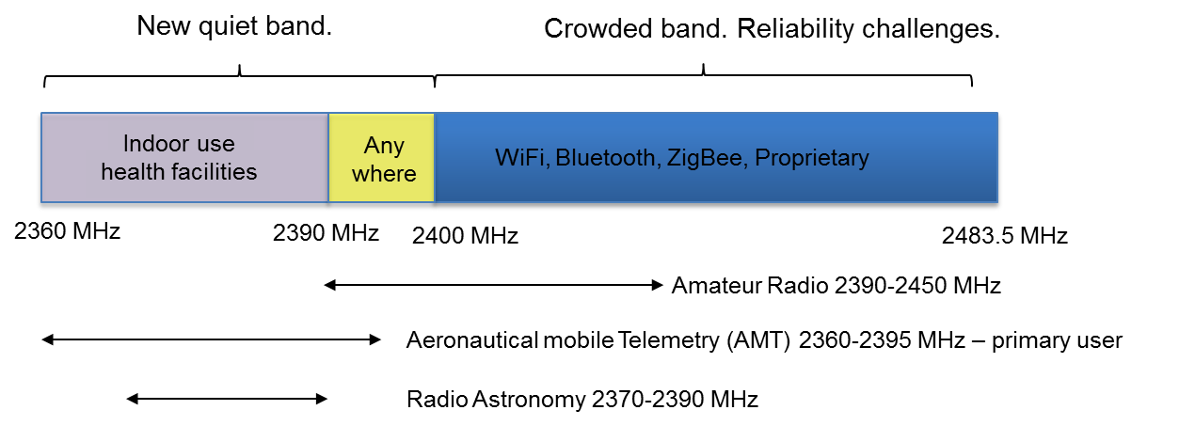
Licensed Medical Band
2.36 to 2.4 GHz band for Medical BAN (MBAN)
  To be shared with primary users: AMT, radio astronomy and amateur
MBAN = medical body area network
AMT = aeronautical mobile telemetry

Slide 20
Medical MBAN/WBAN Standards
802.15.6
  http://www.ieee802.org/15/pub/TG6.html
  Released Amendment
  Covers UWB and 2360-2400 MHz band
802.15.4j
  http://www.ieee802.org/15/pub/TG4j.html
  Defines a physical layer for IEEE 802.15.4 in the 2360 to 2400 MHz band which complies with Federal Communications Commission (FCC) MBAN rules
  Modifications to the MAC to support this new physical layer
  Expected sponsor ballot September 2012
802.15.4n
  http://www.ieee802.org/15/pub/TG4n.html
  Chinese MBAN
MAC = medium access control
MBAN = medical body area network
WBAN = wireless medical body area network

Slide 21
Shared Spectrum - White Spaces
GPS Satellite
Fixed devices require geolocation capability and Internet access to a database of protected radio services.
An 802.11af AP can use the 2.4 GHz band to get to the database and find out the available TVB channels and then switch operation to TVB
IETF PAWS group is developing the database standard
Administrator 1
Administrator 2
DB 1
DB 2
Geolocation
IETF PAWS
Available channels
Mode II Device
Fixed
DB 3
Administrator 3
Mode I Device
TVB = TV band
TVBD = TV band devices
DB = database
IETF = internet engineering task force
PAWS = protocol to access white space
802.11af

Slide 22
VHF/UHF Spectrum
US White Spaces [2] [3]
54-72, 76-88, 174-216, 470-692 MHz
European White Spaces (470-790 MHz)
MHz
Public Safety Broadband (763-768, 793-798 MHz)
Public Safety Narrowband (769-775, 799-805 MHz)
D-Block (758-763, 788-793 MHz)
Low 700 MHz band
(commercial)
High 700 MHz band

Slide 23



PS Licensed 700 MHz Band
D-Block
MHz
758
763
775
788
793
805
Band 13
Band 13
Band 14
Band 14
Guard band
Guard band
Public Safety Broadband (763-768, 793-798 MHz)
Public Safety Narrowband (769-775, 799-805 MHz), local LMR
D Block has recently been allocated to PS
PS = public safety
LMR = land mobile radio

Slide 24
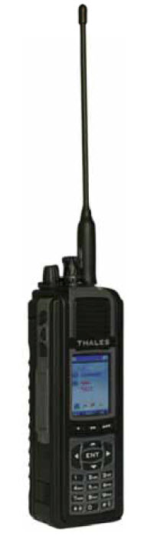


Nationwide PS LTE Network
Spectrum in the 700 MHz band has been licensed by the FCC to carry a nationwide public safety broadband network.
In July of 2009 3GPP LTE was selected as the next generation technology for PS communications.
Today’s PS radio technology includes P25 (digital) and analog LMR (Narrow Band radios).
PS = public safety
3GPP = 3rd generation partnership project
LTE = long term evolution
LMR = land mobile radio

Slide 25
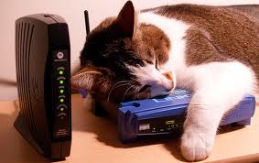
Summary
Wireless networks are growing more diverse and more complex
2G/3G/LTE and Wi-Fi are now set to dominate the indoor and outdoor spaces
Powerful test solutions emulating a variety of operating conditions in the lab will help deliver reliable wireless products to consumers

Slide 26

For More Information
White papers, presentations, articles and test reports on a variety of wireless topics
octoBox controlled environment test solutions
  www.octoscope.com

